Slide 1
01 / 27
PARTAI RAKYAT INDONESIA
PERSATUAN KRISTIANI RAKYAT INDONESIA
AIR AMBULANCE & FLYING HOSPITAL
Bringing Critical Care to Every Island.
STRATEGIC CONCEPT · AUGUST 2026

Slide 2
02 / 27
THE VISION
No Indonesian should be too far from critical care.
Not across the water. Not behind a mountain. Not inside a traffic jam.

Slide 3
03 / 27
THE NATIONAL CONTEXT
Indonesia is not one city. It is an archipelago.
Geography, congestion and uneven specialist access compound delay.
17,000+
ISLANDS SHAPE THE OPERATING CHALLENGE
VERIFIED NATIONAL CONTEXT · BPS-GEO-01

Slide 4
04 / 27
THE PROBLEM
The decisive metric is time to care.
A hospital may exist on the map and remain operationally out of reach.
01 Sea crossings
02 Road congestion
03 Terrain + weather
04 Specialist availability

Slide 5
05 / 27
THE PROPOSITION
Move the capability, not only the patient.
Doctors + equipment + patients + critical care, coordinated as one network.

Slide 6
06 / 27
WHAT IS PERISAI?
A medical aviation operating system.
One command layer connecting patients, hospitals, crews, aircraft and emergency services.
PROPOSED PERISAI CONCEPT

Slide 7
07 / 27
RESPONSE ARCHITECTURE
Match the mission to the response.
Ground · eVTOL · fixed-wing · amphibious · strategic response
01 Clinical priority
02 Weather + route
03 Landing access
04 Hospital readiness

Slide 8
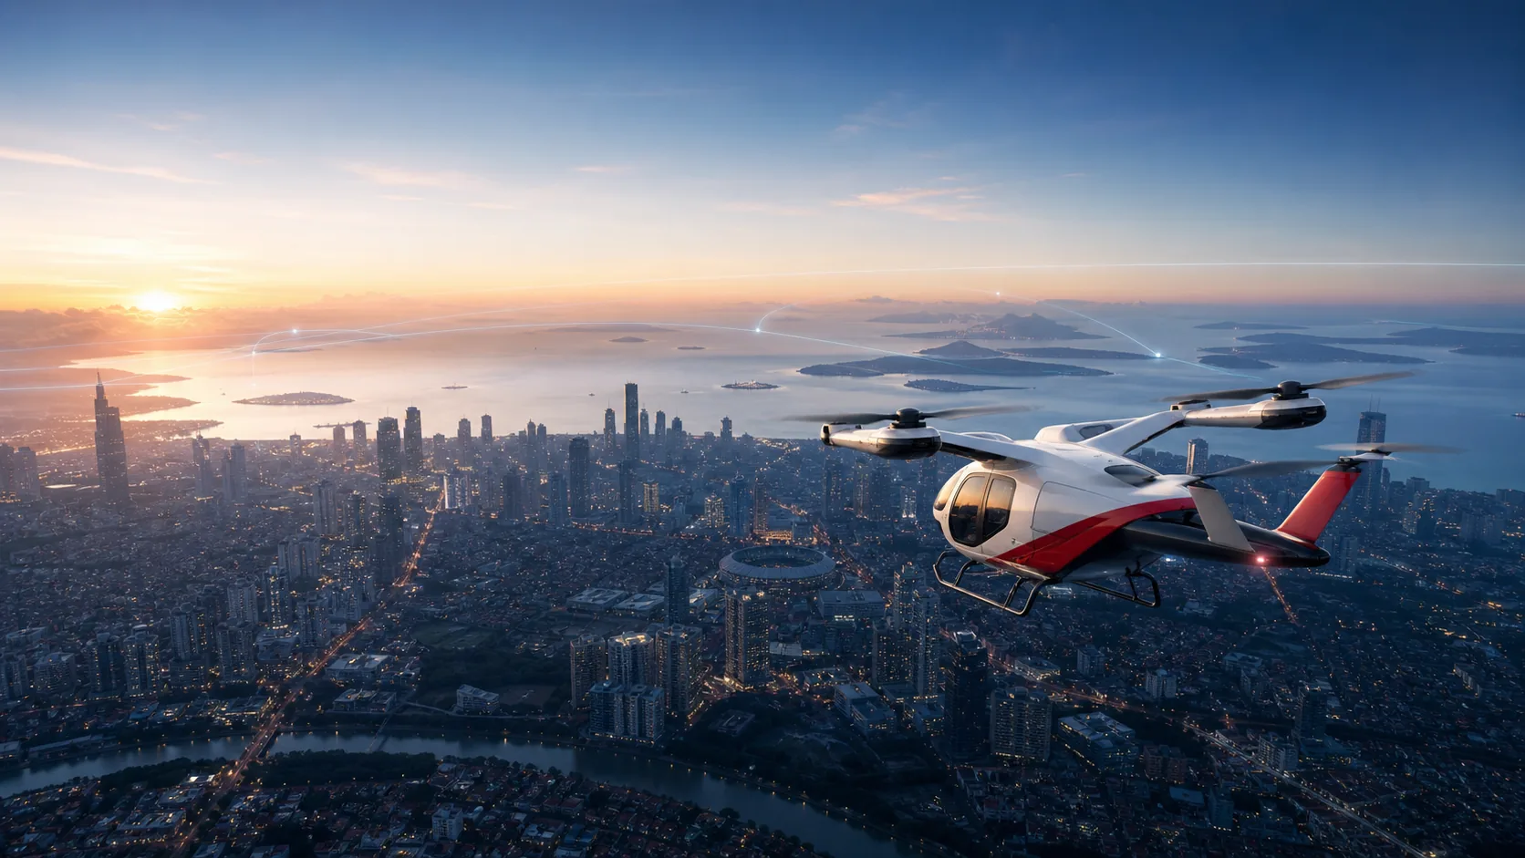
08 / 27
PLATFORM 01
Electric air ambulance.
A proposed medical configuration for selected urban and regional missions.
SUBJECT TO OEM CERTIFICATION AND INDONESIAN APPROVAL

Slide 9

09 / 27
PLATFORM 02
N219 amphibious medical platform.
A proposed flying-doctor and medevac configuration built around a developing domestic platform.
PERISAI MEDICAL CONFIGURATION IS NOT AN EXISTING PTDI PROGRAM

Slide 10
10 / 27
FLYING HOSPITAL PHILOSOPHY
Sometimes the hospital must fly to the patient.
Specialist team → remote community → diagnosis → stabilization → referral decision.

Slide 11

11 / 27
MEDICAL COMMAND
Every launch begins with clinical and aviation gates.
Triage, aircraft selection, weather, crew, landing site and destination readiness.
01 Medical control
02 Flight operations
03 Network intelligence
04 Human authority

Slide 12
12 / 27
NATIONAL NETWORK
National reach. Regional readiness. Local access.
Tertiary centres connect through hubs to local response and remote communities.
ALL HUBS SHOWN ARE PROPOSED PLANNING LOCATIONS

Slide 13
13 / 27
URBAN USE CASE
When road proximity does not mean timely access.
Compare ground and air only with explicit route, speed, preparation and handling assumptions.
ILLUSTRATIVE SCENARIO

Slide 14
14 / 27
REMOTE ISLAND USE CASE
Bring specialist capability closer.
Community clinician → command → flying doctor → telemedicine → transfer if required.

Slide 15
15 / 27
DISASTER RESPONSE
Move people, supplies, diagnostics and communications.
A modular fleet could strengthen medical surge capacity across disrupted terrain.
CONCEPTUAL INTEGRATION ONLY

Slide 16
16 / 27
OPERATING MODEL
Clinical control and flight control as one mission team.
Defined authority, shared readiness gates, auditable handoffs and post-mission learning.

Slide 17
17 / 27
DATA + AI
Decision support, never autonomous diagnosis.
Connect dispatch, weather, telemetry and hospital readiness while preserving human authority.

Slide 18
18 / 27
BUSINESS MODEL
Contracted readiness plus mission activity.
Government, hospitals, remote sites, insurers and assistance companies form a diversified demand base.
POTENTIAL CUSTOMERS · NO AGREEMENTS IMPLIED

Slide 19
19 / 27
ECONOMICS
Expose every assumption.
Lease, crew, maintenance, energy, medical, insurance, technology and compliance.
ILLUSTRATIVE STRATEGIC MODELLING ONLY

Slide 20
20 / 27
DEPLOYMENT
Validate first. Scale through evidence.
Proof of concept → regional network → archipelagic expansion → national grid.

Slide 21
21 / 27
SAFETY + REGULATION
The pathway is a program, not a footnote.
Certification, operator approval, medical governance, infrastructure and data protection move together.

Slide 22
22 / 27
PARTNERSHIP ECOSYSTEM
No single institution can build this alone.
Government · healthcare · aerospace · operators · technology · finance · communities
POTENTIAL STRATEGIC PARTNERS

Slide 23
23 / 27
GOVERNMENT DIRECTION
Medical aviation is entering the national capability conversation.
The November 2025 A400M air-ambulance-module instruction signals relevance—not endorsement, completion or a connection to PERISAI.
GOVERNMENT STATEMENT · GOV-A400M-01

Slide 24
24 / 27
NATIONAL OPPORTUNITY
Build an Indonesian model of medical mobility.
Healthcare equity, disaster resilience and aerospace capability aligned around measurable outcomes.

Slide 25
25 / 27
CALL TO PARTNERSHIP
Turn a national concept into a validated operating program.
Clinical design · regulatory pathway · aircraft validation · pilot geography · funding model

Slide 26
26 / 27
LEGAL
Disclaimer.
PERISAI is presented as a strategic concept and proposed medical-aviation operating model. Aircraft configurations, routes, fleet numbers, financial assumptions, response times, partnerships, regulatory pathways and operational capabilities are illustrative unless explicitly identified as verified facts. Actual implementation requires aviation certification, medical governance, regulatory approval, aircraft OEM validation, infrastructure development, clinical protocols, insurance and operational partnerships.
This presentation is not a government policy document and does not represent an official government program unless separately confirmed by the relevant authority.
REQUIRED DISCLAIMER

Slide 27
27 / 27
PARTAI RAKYAT INDONESIA
PERSATUAN KRISTIANI RAKYAT INDONESIA
AIR AMBULANCE & FLYING HOSPITAL
Critical Care Without Borders.
Bringing Critical Care to Every Island.
Partner With Us · rmafella@gmail.com · Explore the Network
PROPOSED NATIONAL MEDICAL AVIATION NETWORK

